Slide 1
Maven POM.XML ,Settings.xml

Slide 2
settings. xml contains system and/or user configuration, while the pom. xml contains project information.
All build configuration ends up in the pom

Slide 3
settings. xml is not required (and thus not autocreated in ~/. m2 folder) unless you want to change the default settings.
Standalone maven and the maven in eclipse will use the same local repository

Slide 4
settings.xml is your user preferences. It lives in your main Maven directory (usually $HOME/.m2) and holds your own settings, like listings for non-public repositories, usernames, and other personalized configuration.
pom.xml is the control file for each Maven project or module. It tells Maven which dependencies the project needs, what processing to apply to build it, and how to package it when it's ready. The POM is part of the project itself, and so information that's necessary to build the project (such as listing which plug-ins to use when building) should go there.

Slide 5
The repositories for download and deployment are defined by the repositories and distributionManagement elements of the POM.
However, certain settings such as username and password should not be distributed along with the pom.xml. This type of information should exist on the build server in the settings.xml.

Slide 6
A Build profile is a set of configuration values, which can be used to set or override default values of Maven build.
Using a build profile, you can customize build for different environments such as Production v/s Development environments.
Profiles are specified in pom.

Slide 7
The build phases are executed sequentially. When we run a maven build command, we specify the phase to be executed.
Any maven build phases that come before the specified phase is also executed. For example, if we run mvn package then it will execute validate, compile, test, and package phases of the project.

Slide 8
The syntax to execute a goal is:
mvn plugin-prefix:goal
mvn plugin-group-id:plugin-artifact-id[:plugin-version]:goal
Here is an example to execute the dependency tree goal from the command line. It’s not part of any build phases.
mvn dependency:tree

Slide 9
The maven builds executed through the command line runs a set of phases and goals. The pom.xml configuration plays a major role in setting up the project build lifecycle.
The packaging value of pom.xml file defines the set of goals to be executed by the maven build. For example, if it’s jar then the following phases and goals will be executed.

Slide 10
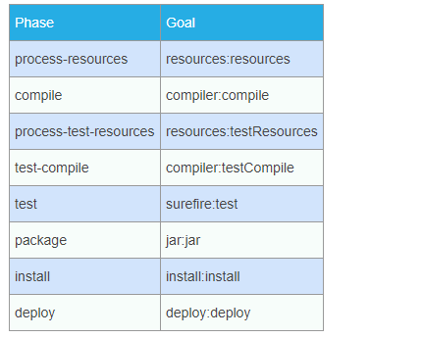

Slide 11
We can also configure goals in the pom.xml file using the plugins element. This is mostly required when you have created a custom plugin and want to execute any specific goal for a build phase.

Slide 12
Life cycle is a sequence of named phases.
Phases executes sequentially. Executing a phase means executes all previous phases.
Plugin is a collection of goals also called MOJO (Maven Old Java Object).
Analogy : Plugin is a class and goals are methods within the class.
Maven is based around the central concept of a Build Life Cycles. Inside each Build Life Cycles there are Build Phases, and inside each Build Phases there are Build Goals.
We can execute either a build phase or build goal. When executing a build phase we execute all build goals within that build phase. Build goals are assigned to one or more build phases. We can also execute a build goal directly.

Slide 13
Three built-in build lifecycles:
default
clean
site
Lifecycle default -> [validate, initialize, generate-sources, process-sources, generate-resources, process-resources, compile, process-classes, generate-test-sources, process-test-sources, generate-test-resources, process-test-resources, test-compile, process-test-classes, test, prepare-package, package, pre-integration-test, integration-test, post-integration-test, verify, install, deploy]
Lifecycle clean -> [pre-clean, clean, post-clean]
Lifecycle site -> [pre-site, site, post-site, site-deploy]
The flow is sequential, for example, for default lifecycle, it starts with validate, then initialize and so on...
You can check the lifecycle by enabling debug mode of mvn i.e., mvn -X <your_goal>

Slide 14
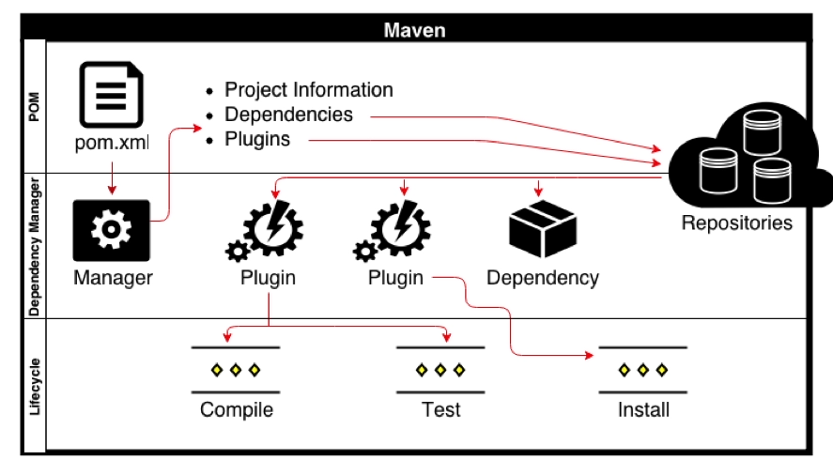

Slide 15
1. Life Cycle vs Phase
Life Cycle is a collection of phase in sequence see here Life Cycle References. When you call a phase, it will also call all phase before it.
For example, the clean life cycle has 3 phases (pre-clean, clean, post-clean).
mvn clean
It will call pre-clean and clean.
2. Plugin vs Goal
Goal is like an action in Plugin. So if plugin is a class, goal is a method.
you can call a goal like this:
mvn clean:clean
This means "call the clean goal, in the clean plugin" (Nothing relates to the clean phase here. Don't let the word"clean" confusing you, they are not the same!)

Slide 16
3. Now the relation between Phase & Goal:
Phase can (pre)links to Goal(s).
For example, normally, the clean phase links to the clean goal. So, when you call this command:
mvn clean
It will call the pre-clean phase and the clean phase which links to the clean:clean goal.
It is almost the same as:
mvn pre-clean clean:clean
More detail and full examples are in https://www.surasint.com/maven-life-cycle-phase-and-goal-easy-explained/

Slide 17
Build lifecycle of Maven.
The three build lifecycles are −
clean: cleans up artifacts created by prior builds.
default: used to build the application.
site: generates site documentation for the project.

Slide 18
Different phases of a Maven Build Lifecycle
Different types of Build Profiles:
Build profiles are of three types −
Per Project − Defined in the project pom.xml file.
Per-User − Defined in Maven settings XML file &#40;%USER_HOME%/.m2/settings.xml&#41;
Global −Defined in Maven global settings xml file &#40;%M2_HOME%/conf/settings.xml&#41;

Slide 19
The chosen answer is great, but still I would like to add something small to the topic. An illustration.
It clearly demonstrates how the different phases binded to different plugins and the goals that those plugins expose.
So, let's examine a case of running something like mvn compile:
It's a phase which execute the compiler plugin with compile goal
Compiler plugin got different goals. For mvn compile it's mapped to a specific goal, the compile goal.
It's the same as running mvn compiler:compile
Therefore, phase is made up of plugin goals.

Slide 20
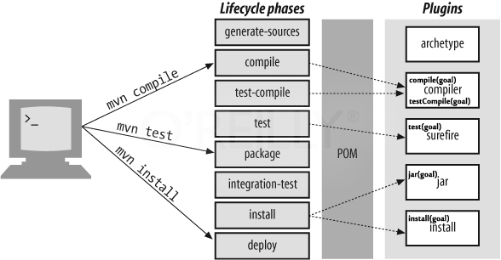

Slide 21
https://www.journaldev.com/33645/maven-commands-options-cheat-sheet

Slide 22
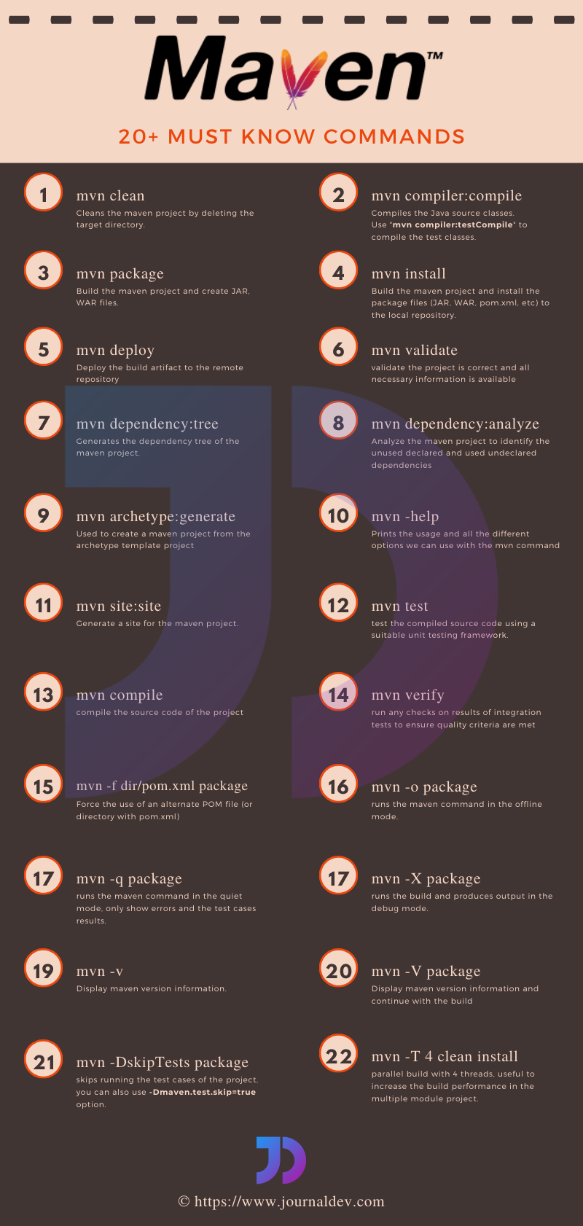

Slide 23
https://www.edureka.co/blog/interview-questions/maven-interview-questions/

